Slide 1


Visual Analysis of Chess Openings
This project analyzes chess opening trends using data from millions of Lichess online games.
We visualize opening behavior and outcomes to guide better strategy selection.
Devin Bedi(23106015)
Rupesh Sharma(23106020)

Slide 2

Problem Statement and Objectives
Problem
Players struggle to identify effective openings amid vast online data.
Goal
Visualize and understand opening popularity and performance over seven months.

Slide 3
Data Collection & Preprocessing
Data Source
Master Dataset
Columns
Lichess monthly datasets covering 7 months in PNG format.
Date, Player Info, Ratings
Opening ECO codes and names
Processing
Game results, length, and time control
Parsed PNGs for extraction
Cleaned and filtered records
Merged into master dataset

Slide 4

Tools and Technologies
Languages
Visual Studio Code and Lichess.org datasets
Python for data extraction, cleaning, visualization
pandas, numpy
Libraries
Environment & Data
matplotlib, seaborn, plotly

Slide 5
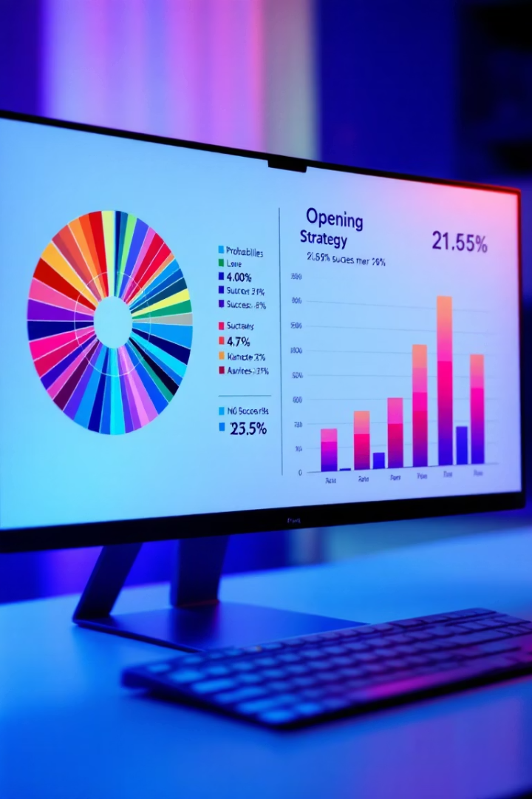




Key Insights and Observations
Sunburst Chart
Animated Line Chart
Faceted Line Chart
Queen’s Pawn Game and Caro-Kann are the most favored. Queen’s Pawn has a higher draw tendency than others.
Queen’s Pawn Game stayed consistently popular. Van’t Kruij’s Opening showed the most fluctuation over time.
Scandinavian Defense is stable with balanced outcomes. The Accelerated London System is volatile—ideal for high-risk players.
Trend Lines & KDE
Violin Plot
Most popular openings cluster around an average ELO of 1800, indicating mid-level to advanced player usage
Bullet games show high variation due to their speed, while blitz games dominate in length. Rapid games remain the most stable.

Slide 6
Integrating Chess and Data Science
Bridging Chess and Data Science This project merges chess strategies with data science for deeper insights.
Insights from Visualizations Visualizations revealed behavioral trends in popular chess openings.
Data-Driven Decision Making Emphasizes the importance of data in enhancing chess decision-making.

Slide 7





Project Workflow
Data Extraction
Processing
Visualization
Insights
Copy and edit PNG data from Lichess datasets
Python scripts for filtering and merging data
Create diverse charts revealing opening dynamics
Analyze patterns and draw conclusions

Slide 8
Future Scope & Conclusion
Future Directions
Conclusion
Develop interactive web visualizations with Plotly Dash
Data science bridges chess strategy with actionable insights.
Incorporate real-time chess tracking and country statistics
Visual analytics empower players to refine opening choices.
Explore AI for move prediction using deep learning models
Promotes data-driven decision-making in competitive chess.

